Slide 1
Business Process Engineering
Week # 2
FALL-2025

Slide 2
Business Process - Recall
A business process consists of a set of activities that are performed in coordination in the organizational and technical environment
  These activities jointly realize a business goal
  Each business process is enacted by a single organization, but it may interact with business processes performed by other organizations

Slide 3
Business Process - Recall
A collection of inter-related events, activities and decision points that involve a number of actors and objects, and that collectively lead to an outcome that is of value to at least one customer.

Slide 4
Examples of Business Processes
Order-to-cash
Quote-to-order
Procure-to-pay
Issue-to-resolution
Application-to-approval

Slide 5
Basic Concepts Mathias Weske
Event:An event is a specific instant of time, which makes the start or end of an activity.
Task - a logical unit of work that is carried out as a single whole
Resource - a person or a machine that can perform specific tasks
Activity - …
Case - a sequence of activities performed by an actor to achieve some goal, an order, an insurance claim, a car assembly
Process - describes how a particular category of cases shall be managed
Control flow construct - sequence, selection, iteration, parallelization
Actors: human actors, organizations, or software systems acting on behalf of human actors or organizations

Slide 6
Output of a Business Process
Positive outcome – the value is delivered to the actors involved
Negative outcome – the value is not achieved or is only partially achieved

Slide 7
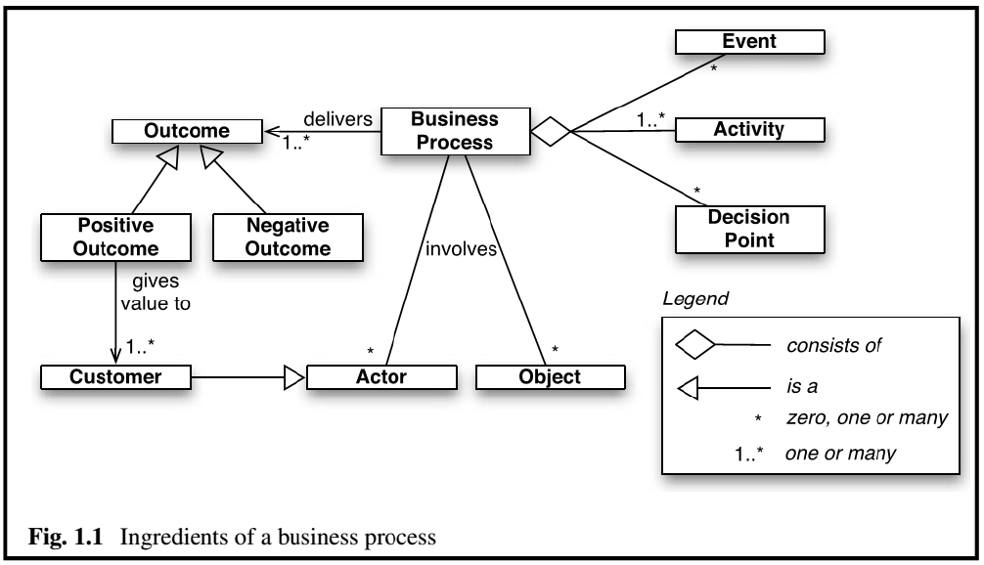


Slide 8
Business Process Management (BPM)
BPM is the art and science of overseeing how work is performed in an organization to ensure consistent outcomes and to take advantage of improvement opportunities.
  Improvement may include reducing costs, reducing execution times and reducing error rates

Slide 9
Business Process Management(Cont.)
Methods, techniques and tools to discover, analyze, redesign, execute and monitor business processes.
  Managing entire chains of events, activities, and decisions= BPM

Slide 10
Business Process Management(Cont.)
Every business has goals and BPM ensures the exact steps a business will take to achieve those goals.
what happens if a process
  isn’t achieving the result
OR
if it’s not achieving it very effectively?

Slide 11
Business Process Management(Cont.)
BPM asks: “is this really the best way to do it”
Processes are said to be managed when they’re kept up to date, tested and optimized.
Since the nature of business is always changing because companies change size quickly and the tools they use change, processes have a terrible tendency to become outdated.
Notes:
Have you ever looked through a process document and thought ‘yeah, we don’t do that at all’? It’s lack of BPM that’s lead up to that moment.
Well optimized business procedures save time and company money because time wasted following poor processes compounds every time the process is run. If hundreds of people run a bad process hundreds of times, you could lose out on weeks of your year without noticing, leading to a massive dip in revenue and no proper explanation.

Slide 12
Business Process Management(Cont.)
BPM= creating and optimizing the perfect plans to achieve business goals.
Whether or not someone in the company has it in their job title or description, business processes are in a constant state of flux.
BPM is always questioning the current state of operations.

Slide 13
Business Process Management(Cont.)
An important feature of BPM is ownership and collaboration.
Processes should be owned by people, and those people are responsible for updating and optimizing them.
The best people to be in charge of creating and maintaining their own processes are those responsible for doing the tasks
  The support team takes care of the support processes, and anyone else who uses these processes can make edits and suggestions to optimize them, based on collective feedback

Slide 14
BPM Activities
6/6+ Step Activities
Analyze
Model
Implement
Monitor
Manage
Automate
5 Step Activities
Designing
Modelling
Executing
Monitoring
Optimization

Slide 15
BPM Activities: Design
Process Design encompasses both the identification of existing processes and the design of "to-be" processes.
The aim is to ensure that a correct and efficient theoretical design is prepared.
The proposed improvement could be in human-to-human, human-to-system, and system-to-system workflows, and might target regulatory, market, or competitive challenges faced by the businesses.

Slide 16
BPM Activities: Modeling
Modeling takes the theoretical design and introduces combinations of variables (e.g., changes in rent or materials costs, which determine how the process might operate under different circumstances).
It also involves running "what-if analysis" on the processes: "What if I have 75% of resources to do the same task?" "What if I want to do the same job for 80% of the current cost?".

Slide 17
BPM Activities: Execution
Process Automation is:
  to develop/purchase an application that executes the required steps of the process,
  to use a combination of software and human intervention –
  Developed software enables the full BP to be defined in a computer language directly executed by the computer. The system will use services in connected applications to perform business operations, or, when a step is too complex to automate, will ask for human input.
A business rule engine can be used to drive process execution and resolution

Slide 18
BPM Activities: Monitoring
Tracking of individual processes, so, that information on their state can be easily seen, and statistics on the performance of one or more processes can be provided.
The degree of monitoring depends on what information the business wants to evaluate and analyze and how business wants it to be monitored, in real-time, near real-time or ad-hoc.

Slide 19
Process mining is a collection of methods and tools related to process monitoring. The aim of this is to analyze event logs extracted through process monitoring and to compare them with an a priori process model. It allows to detect discrepancies between the actual process execution and the a priori model.

Slide 20
BPM Activities: Optimization
Process optimization includes retrieving process performance information from modeling or monitoring phase; identifying the potential or actual bottlenecks and the potential opportunities for cost savings or other improvements; and then, applying those enhancements in the design of the process.

Slide 21
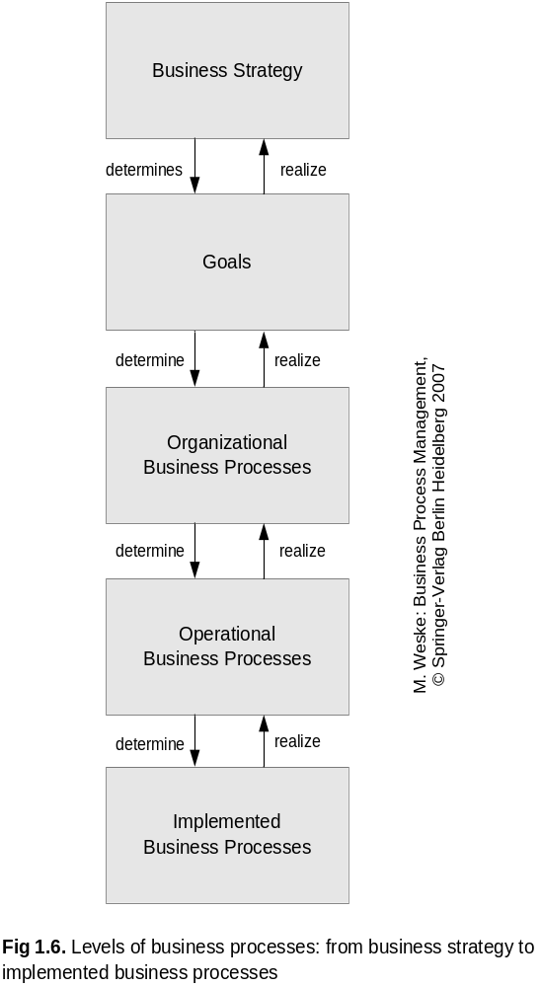
Business Processes Hierarchy
  Business Strategy describes long-term concepts to develop a sustainable competitive advantage e.g. cost leadership for products
  Strategy is broken down into operational goals
    e.g. Reducing the cost of material

Slide 22
Business Processes Hierarchy
Organizational Processes
  High level
  Specified in textual form by
    Inputs
    Outputs
    Expected results
    Dependencies on other processes
  e.g. process to manage incoming raw materials provided by a set of suppliers

Slide 23
Business Processes Hierarchy
Operational Processes
  There are multiple operational processes that contribute to organizational process
  In operational processes activities and their relationships are specified
  Operational process are specified by process models

Slide 24
Business Processes Hierarchy
Operational Processes are basis for developing implemented processes
Implemented processes contain information on the
  execution of process activities
  technical and organizational environment in which they will be executed

Slide 25
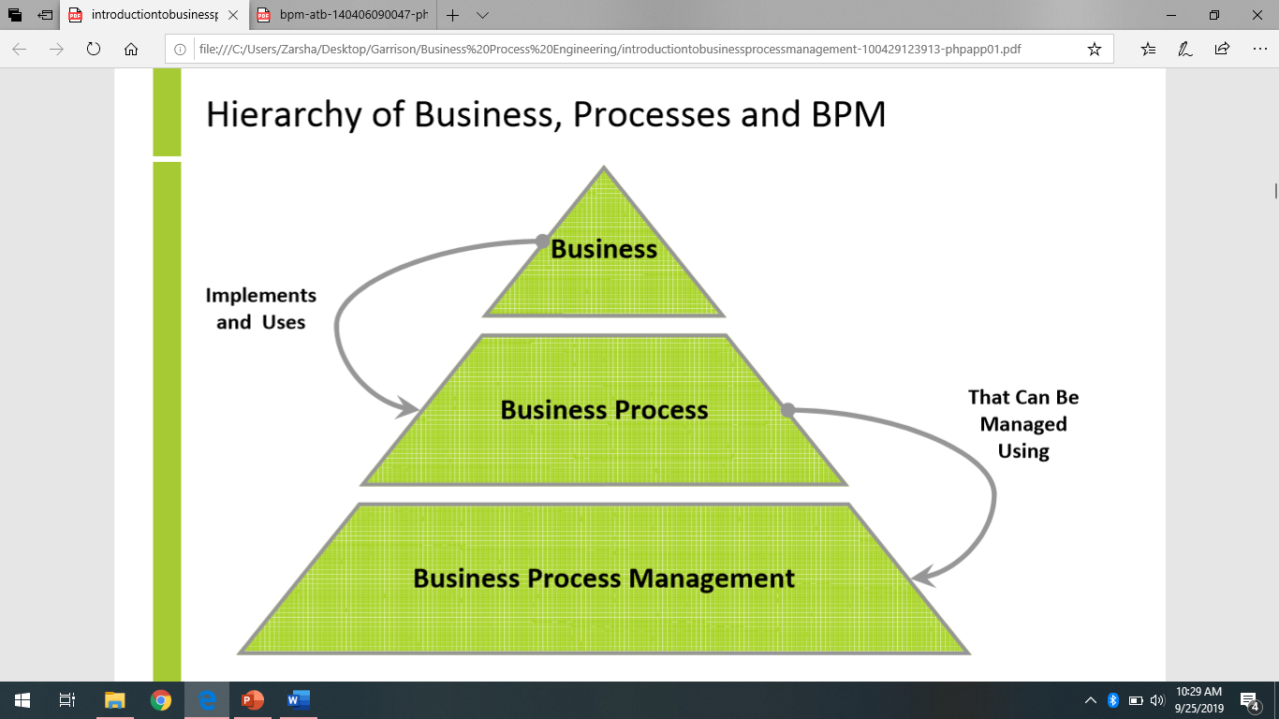

Slide 26
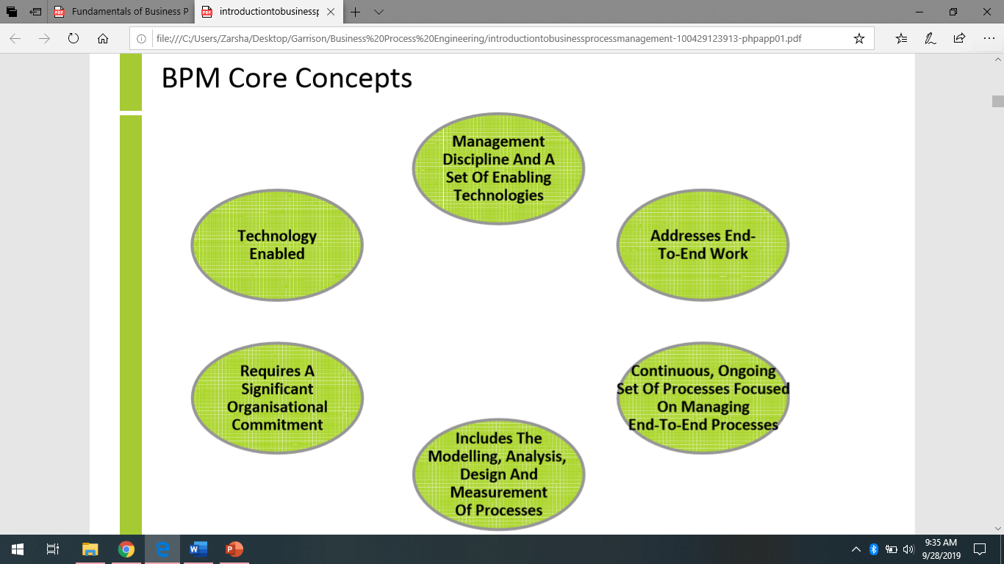
Notes:
BPM is a management discipline and a set of enabling technologies
BPM addresses end-to-end work and distinguishes between sets of subprocesses, tasks, activities and functions
BPM is a continuous, ongoing set of processes focused on managing an organization's end-to-end business processes
BPM requires a significant organizational commitment, often introducing new roles, responsibilitBPM includes the modelling, analysis, design and measurement of an organization's business processes
ies and structures to traditional functionally oriented organizations
BPM is technology enabled with tools for visual modelling, simulation, automation, integration, control and monitoring of business processes and the information systems which support these processes
BPM acronym used loosely and its meaning varies depending upon the context
Software companies often refer to BPM to describe the capabilities of a particular product or technology
Practitioners, management consultants and academics typically discuss the process and management discipline of BPM
Firstly BPM is a management discipline and process for managing an organization's business processes
Enabling technology is meaningless without the management disciplines and processes for exploiting the technology
BPM involves managing the end-to-end work organizations perform to create value for their customers
Performance of this work is essentially how organizations fulfill their mission
Vendors have created application suites which help enable organizations to better manage their business processes
Tools to visually design and model business processes −Simulate and test business processes, automate, control and measure business processes −Provide feedback and reporting on process performance
Some vendors have combined these into integrated business process management suites Most large organizations have a significant investment into a number of legacy systems Designed to support specific functions
In order to manage the end-to-end work involved in business processes, a BPMS must be able to integrate with legacy systems in order to control work, get information or measure performance
Common framework for how these technologies are deployed is most often referred to as a Service Oriented Architecture (SOA)
Standardizing on a specific set of open technologies commonly referred to as web services −By leveraging web services in a SOA, organizations can build and manage end-to-end business processes across organizational silos and their legacy systems

Slide 27
Importance of BPM
Allows organizational leaders to understand, analyse and improve the various processes that happen within their organization
Allows organizational leaders to optimize end-to-end business processes to have a greater impact on outcomes
Well-executed BPM can reduce waste, cut down on errors, save time and generate better services and products
Well-executed BPM continually delivers improvements
Realize bigger organizational goals
Move toward digital transformation

Slide 28
Emergence of Business Process Management Systems (BPMSs)
Process-oriented organizations did better than non-process-oriented organizations in terms of gaining efficiency and satisfying their customers
Emergence of different types of IT system
  Enterprise Resource Planning (ERP) Systems – store all data related to the business operations of a company in a consistent manner, so that all stakeholders who need access to these data can gain such access
  Workflow Management System (WfMS) – distribute work to various actors in a company on the basis of process models

Slide 29
Types of BPM Systems
Integration-Centric BPM
  Handles processes that primarily jump between existing systems e.g., HRMS, CRM, ERP without much human involvement
Human-Centric BPM
  Primarily executed by humans; have a lot of approvals and tasks performed by individuals
Document-Centric BPM
  When a document e.g., a contract or agreement is at the heart of the process. Enable routing, formatting, verifying, and getting the document signed as the tasks pass along the workflow

